Slide 1
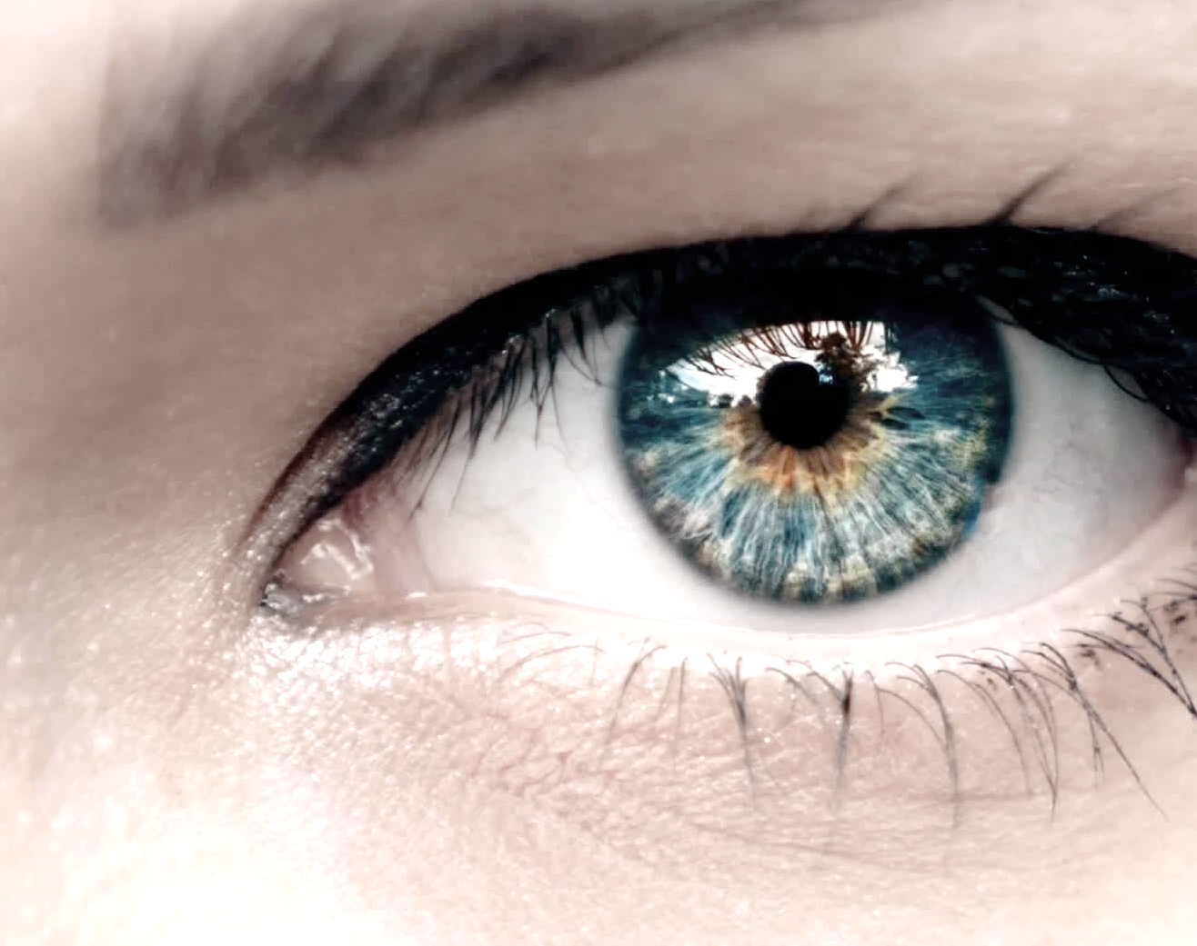
Smart health monitoring by detecting human eyes irises and pupils

Slide 2

Problem Statement
Modern living brings stress that increases mental issues​
Current stress measurement relies mainly on subjective questionnaires​
Other monitoring methods requiring specialized equipment
Need for a convenient and objective approach

Slide 3
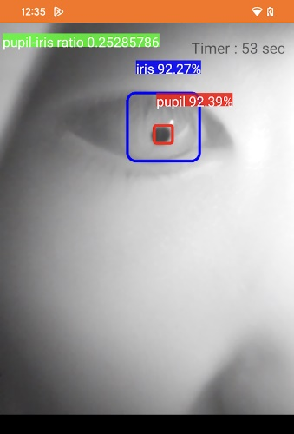
Proposed Solution: Monitoring Pupil Size Variation on Smart Phone
Convenient - only requires a camera
Objective indicator - reflects changes in autonomic nervous system activity
Low-cost equipment - widely available webcams or smartphone cameras can be used

Slide 4
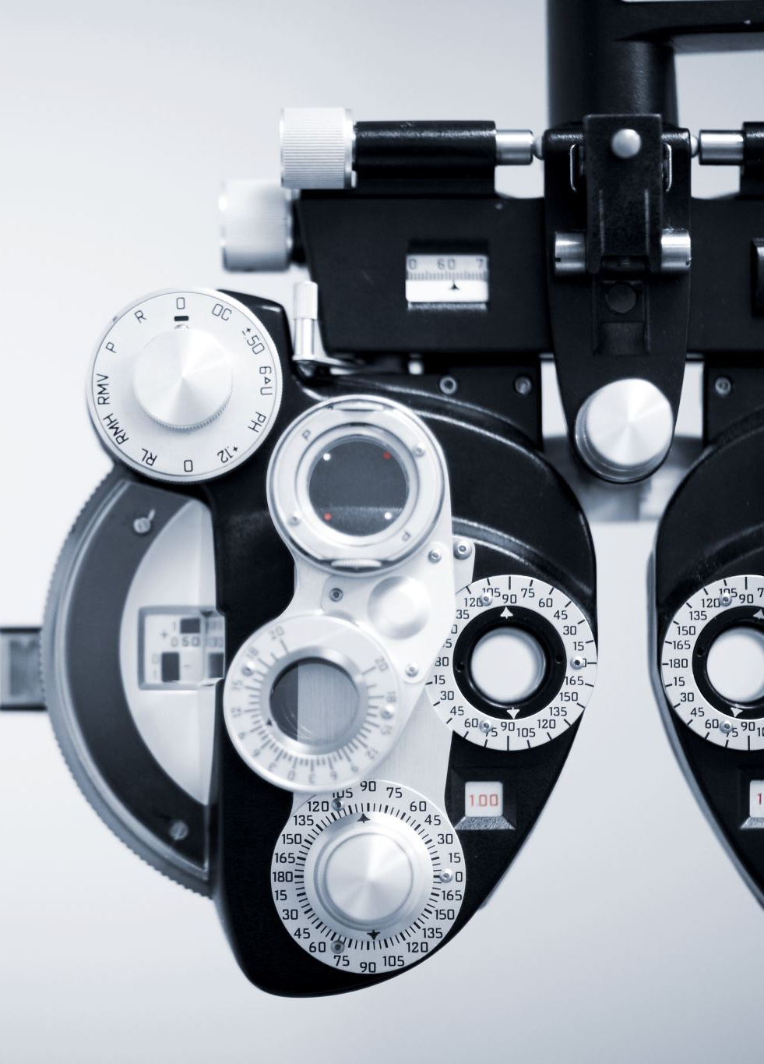
Current Research
Hirt, C., Eckard, M., & Kunz, A. (2020) " Stress generation and non-intrusive measurement in virtual environments using eye tracking "
VR headset eye tracker
Analyzed pupil responses in VR tasks
Veltman, J. A., & Gaillard, A. W. K. (1998). " Physiological workload reactions to increasing levels of task difficulty"
Use multiple physiological sensors (including Eye-Trac eye tracker)
Monitor physiological reactions to increasing levels of task difficulty
Can it be done using some simple instruments?

Slide 5






Why use smart phone
HONG KONG HAS A 97% SMARTPHONE PENETRATION RATE (2023) ¹
SMARTPHONES HAVE HIGH-RESOLUTION FRONT-FACING CAMERAS
DEDICATED PROCESSORS OPTIMIZED FOR COMPUTER VISION TASK
NO SPECIALIZED EQUIPMENT REQUIRED, ONLY A SMARTPHONE
COST-EFFECTIVE AND SCALABLE FOR DAILY MONITORING

Slide 6

Objective
Evaluate the effectiveness of pupil-to-iris ratio (PIR) in detecting stress levels in smartphone
Compare PIR with the traditional heart rate variability (HRV) method
Demonstrate the reliability of smartphones as a stress assessment tool

Slide 7
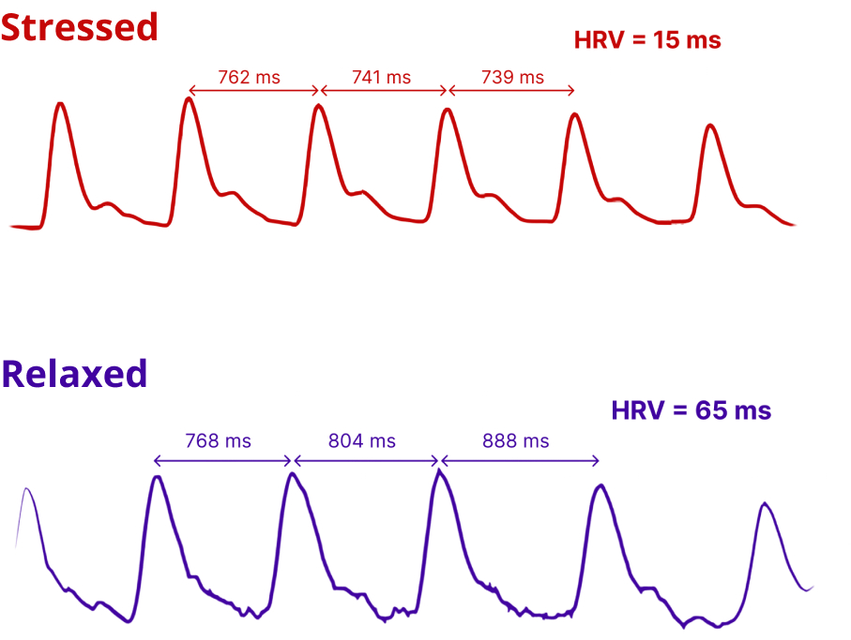
Relationship between Heart Rate Variability(HRV) and Stress Levels
HRV measures variations in time between heartbeats
Low HRV indicates higher stress levels²

Slide 8
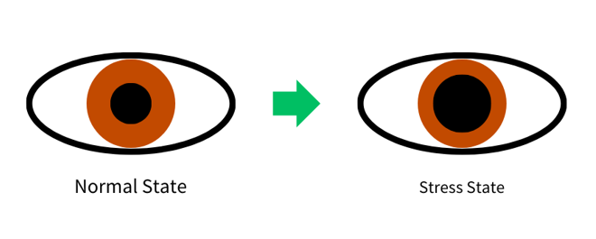
Relationship between Pupil Size and Stress Levels
Pupil dilates (gets larger) when exposed to stressors³
Larger pupil size indicates higher stress levels

Slide 9
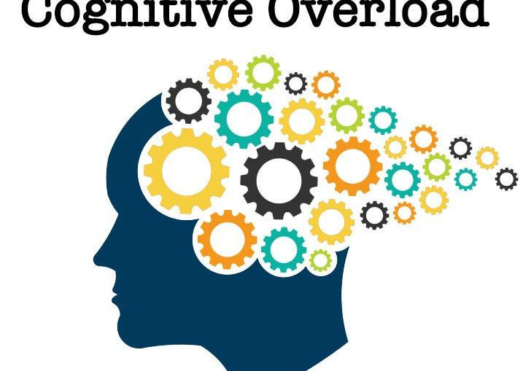
Control Cognitive Load and Stress Levels
High cognitive load can lead to overload working memory capacity
Task difficulty and time pressure increase cognitive load induce stress

Slide 10
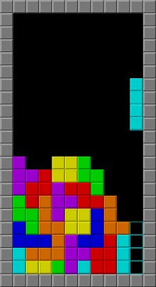
Use Tetris induced stress
Setting higher difficulties of Tetris induced stress significantly ⁴
Control task difficulty
Simple task is the relaxed state (e.g. Level 1)
Difficult task is the stressed state (e.g. Level 15)

Slide 11

Experiment
Two Experiments on Stress Detection
First Experiment • Results (not ideal)
Second Experiment • Improved setups(As expected)

Slide 12
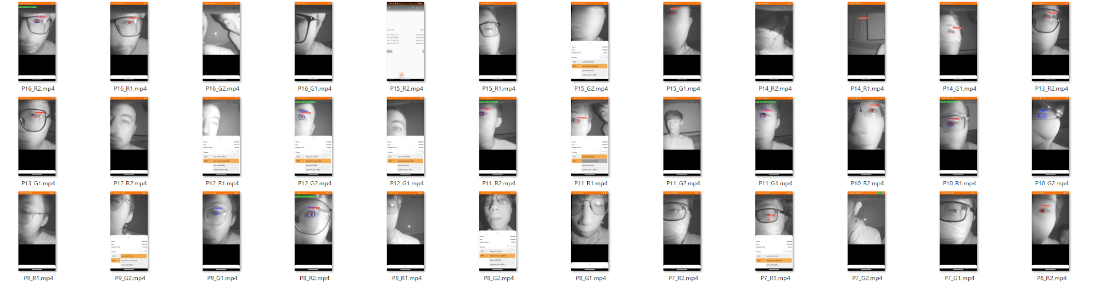
Research ethics
Participants briefed before the experiment
Required to sign consent form
Experimental process video recorded for:
Documentation
Validation

Slide 13
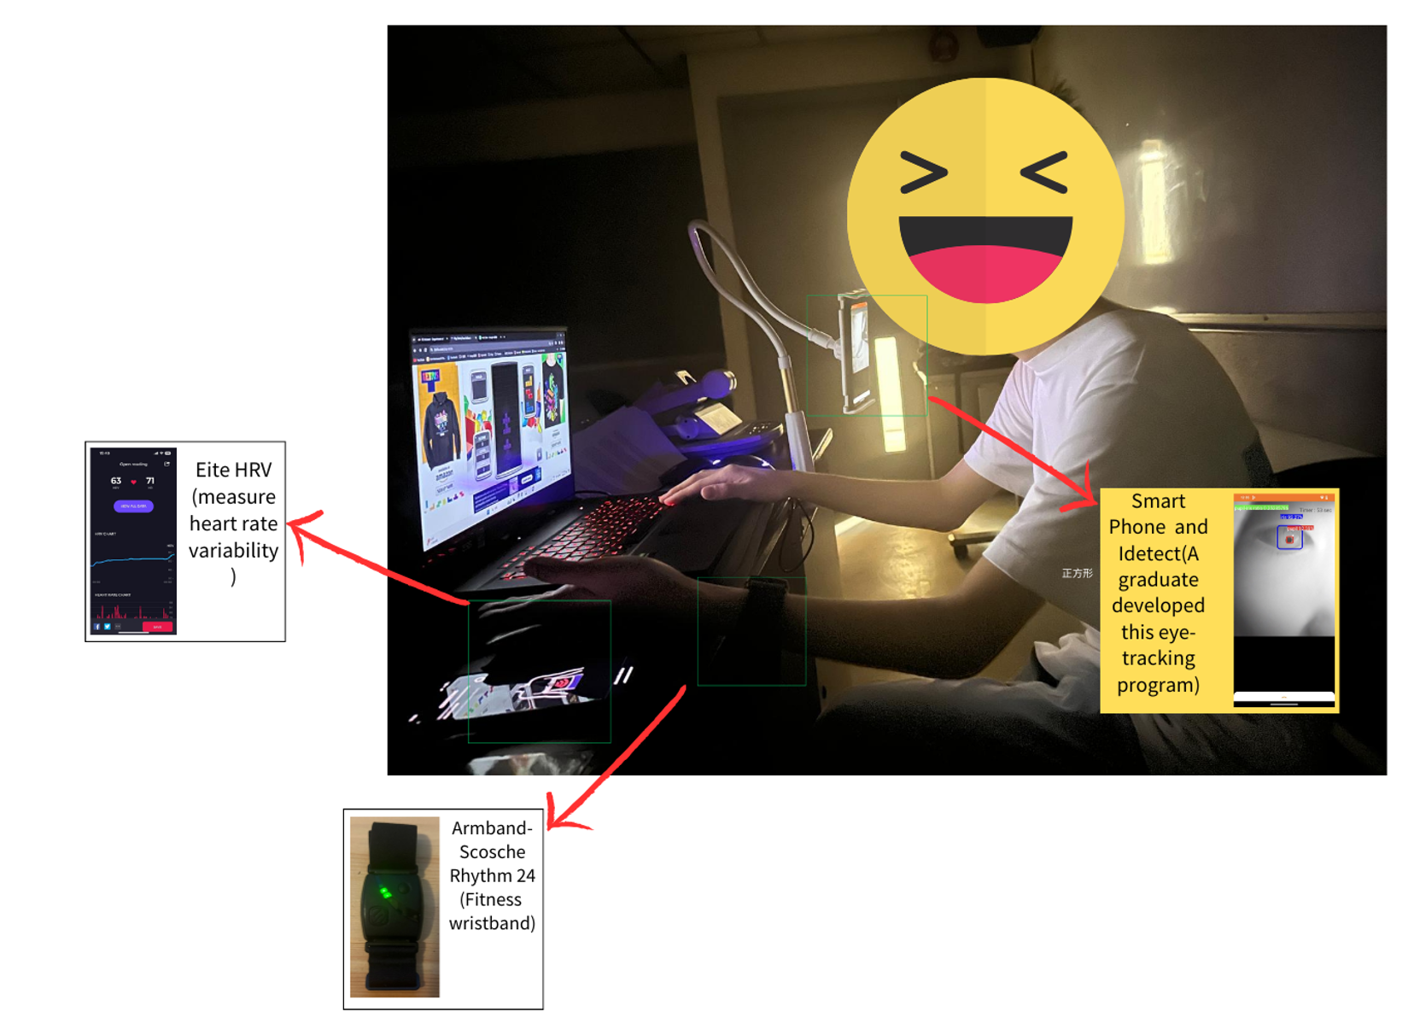
Experiment Setup

Slide 14

First Experiment
18 subjects
Participants are required to remove their glasses
Easy difficulty is set to Level 1 and Hard mode is set to Level 10

Slide 15
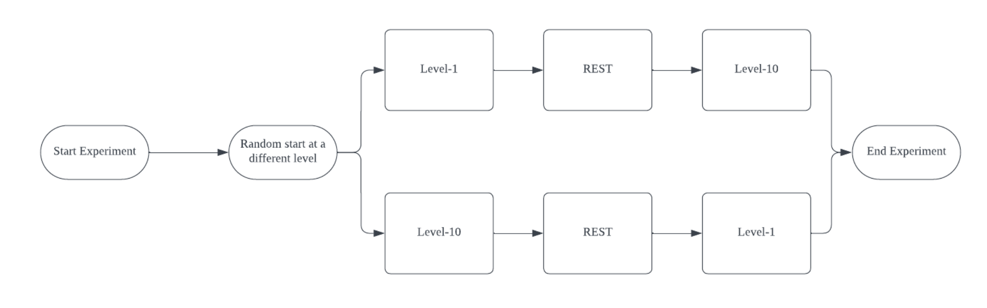
First Experiment Procedure:
Experimental Procedure:
Participants randomly play Tetris for 5 mins (easy or difficult level)
Use phone camera app to record pupil/iris ratio
Simultaneously record heart rate variability(HRV) with wristband
5-minute break
Play Tetris for 5 mins at opposite difficulty level
Repeat Steps 2 & 3 to record data

Slide 16
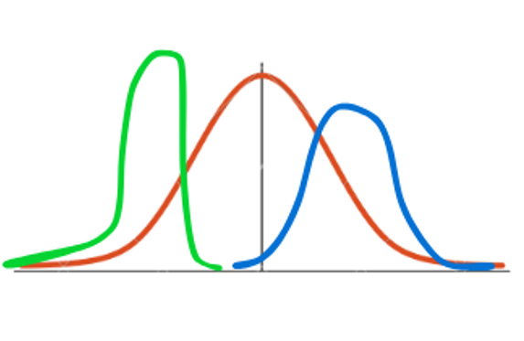
Statistical Method- Non Parametric
The sample sizes is small(<30)
Cannot assume normal distribution
Non-parametric tests do not require strict distributional assumptions

Slide 17
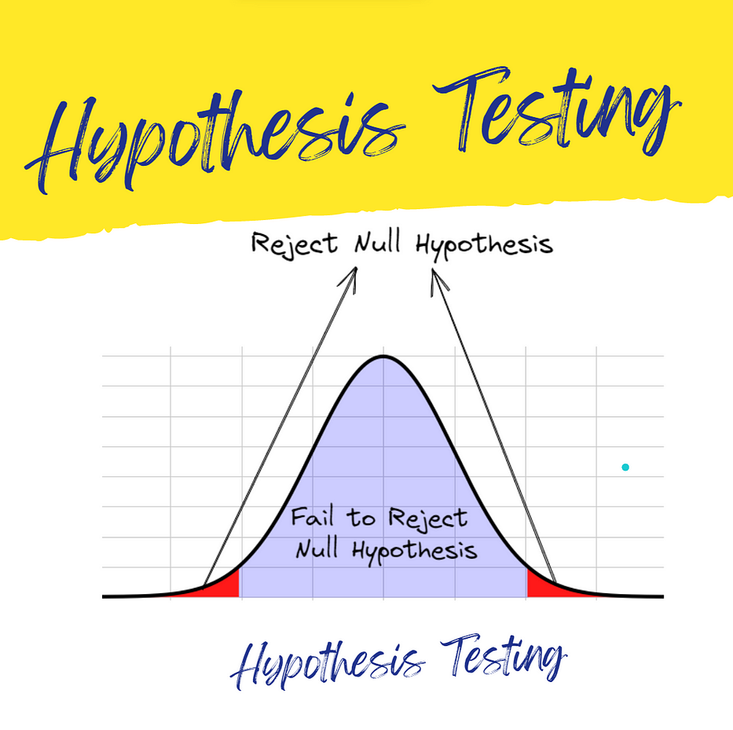
Statistical Method- Hypothesis Testing
Sign Test
Uses signs of sample differences
Null Hypothesis (H0): The proportion of differences between the two conditions is 0.5
Alternative Hypothesis (H1): The proportion of differences between the two conditions is not equal to 0.5
Wilcoxon Rank Sum Test
Compares medians of two independent samples
Null Hypothesis (H0): The distributions of the two conditions are the same.
Alternative Hypothesis (H1): The distributions of the two conditions are different.

Slide 18
P-value ranges
Significance Level (α) | p-value Range (Significant Result) | Interpretation
0.001 | p < 0.001 | Extremely Significant
0.01 | 0.001 <= p < 0.01 | Highly Significant
0.05 | 0.01 <= p < 0.05 | Significant
0.10 | 0.05 <= p < 0.10 | Weak Significant
p >= 0.10 |  | Not Significant

Slide 19
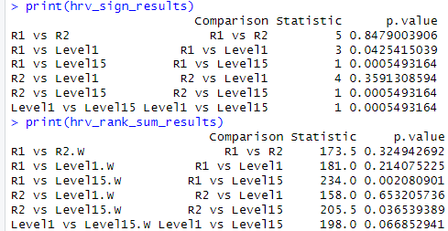

Using R for Data Analysis and Hypothesis Testing
Open-source and free
Rich statistical analysis libraries
Powerful data visualization

Slide 20
Result (HRV on different difficulty levels)
Could't find any difference based on p value
 | Sign Test | Wilcoxon signed rank test
P value | 1 | 0.1707

Slide 21

Lack of Significant HRV Changes
Possible reasons
Game Difficulty Level
Difficulty level 10 may not have been challenging enough
Frequent gamers might not experience significant stress
Insufficient sympathetic activation and reduction in HRV
Heart Rate Monitoring Device Placement
Device worn on dominant hand used for game control
Hand movements could introduce measurement errors/artifacts

Slide 22
Result(Pupil size on different levels)
 | Sign Test | Wilcoxon signed rank test
P value | 1 | 0.4375
Couldn't find any difference based on p value

Slide 23

Lack of Significant Pupil Size Changes
Task Difficulty Level
Highest level (Level 10) may not have been challenging enough
Cognitive load needs to reach a certain intensity threshold
Level 10 difficulty did not elicit noticeable pupil dilation
Participants Wearing Glasses
Required to remove glasses temporarily for eye imaging
They saw the screen is blurry maybe would affect pupil size

Slide 24

Modifications to Experimental Procedure
1.Glasses Wearing
Participants permitted to wear glasses throughout experiment
Avoids fluctuations in pupil size from glasses removal/reapplication
Heart Rate Monitor Placement
2.Worn on non-dominant hand
Mitigates motion artifacts from computer operation
Increased Task Difficulty
3.Tetris difficulty level increased from 10 to 15
Presents a more challenging task to elicit physiological responses
4.Additional Data Points
Baseline readings before start the experiment
Intermediate readings between difficulty levels

Slide 25
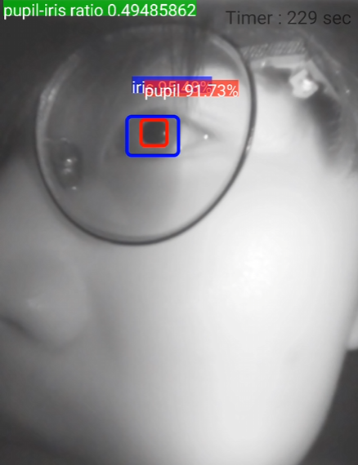
Second Experiment
17 subjects
Participants are allow wear their glasses (Not seriously reflective )
Easy difficulty is set to Level 1 and Hard mode is set to Level 15

Slide 26
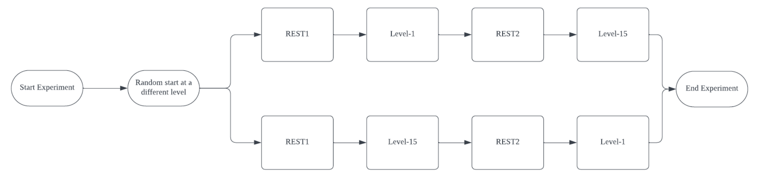
Experiment Procedure

Slide 27
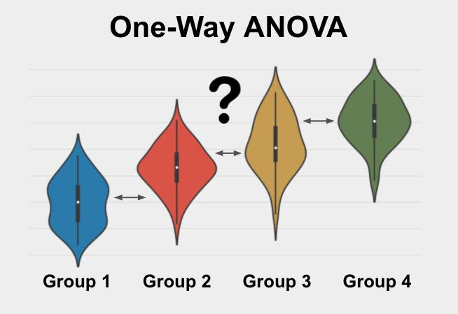
One Way ANOVA Test
Test for differences among three or more group means
Determine if the means of the groups are significantly different

Slide 28
One Way ANOVA Test Result
Classes | P-value
HRV | 0.0000000008599193
Pupil size | 0.000001180165
At least one on group among them have significant difference

Slide 29
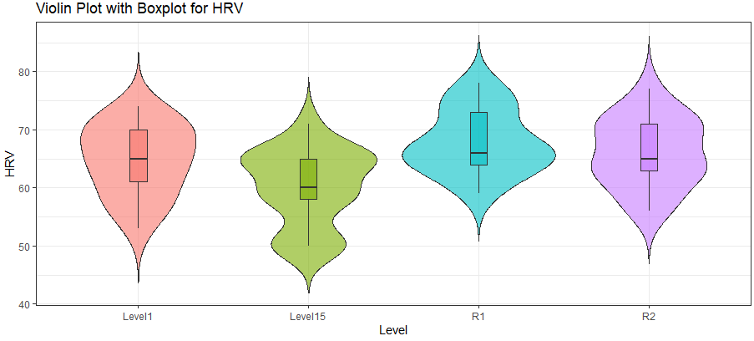
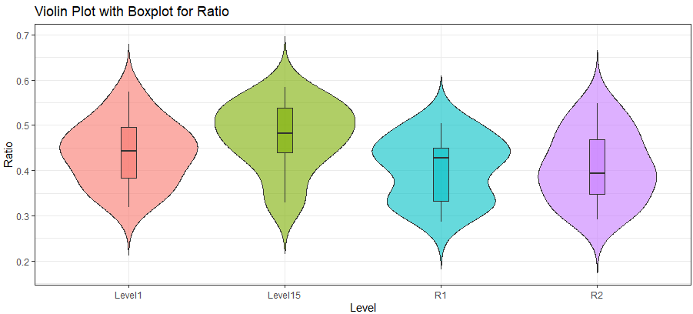
Distribution of each group

Slide 30

Post-Hoc tests
Identify which specific group pairs have significant difference
Use Sign & Sign Rank Tests to compare each group

Slide 31
Simplify Keyword
G1: Easy level (Normal state)
G2: Difficult level (Stress state)
A baseline measurement (R1) is taken before starting, and the two gaming conditions have a break (R2).

Slide 32
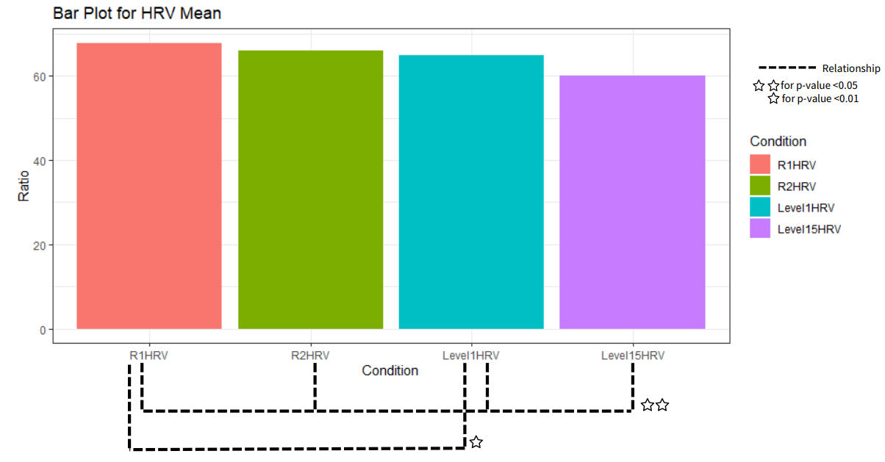
Sign Test Results(HRV)
HRV at level 15 has a significant relationship with others
R1 and level 1 has weak relationships(why?)
Pair of Group | P-value
R1 vs R2 | 0.8479003906
R1 vs Level1 | 0.0425415039
R1 vs Level15 | 0.0005493164
R2 vs Level1 | 0.3591308594
R2 vs Level15 | 0.0005493164
Level1 vs Level15 | 0.0005493164

Slide 33
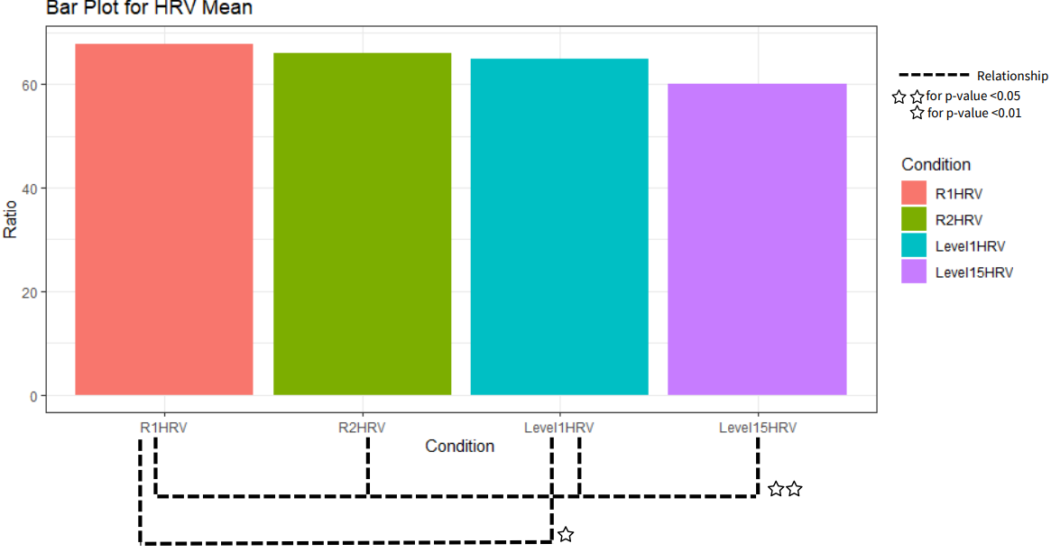
Wilcoxon rank sum test Result(HRV)
HRV at level 15 has a significant relationship with others
Pair of Group | P-value
R1 vs R2 | 0.324942692
R1 vs Level1 | 0.214075225
R1 vs Level15 | 0.002080901
R2 vs Level1 | 0.653205736
R2 vs Level15 | 0.036539389
Level1 vs Level15 | 0.066852941

Slide 34


Experimental Findings (HRV)
HRV IS EXPECTED TO BE LOWER DURING TIMES OF STRESS
HRV DATA PROVIDES A STRONG BENCHMARK FOR VALIDATING PUPIL RESPONSE

Slide 35
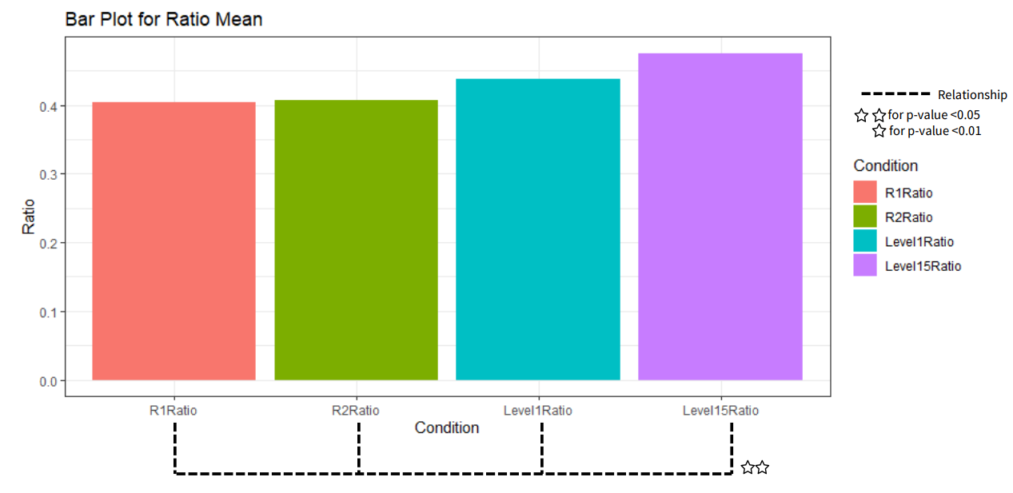
Sign Test Results(Pupil Size)
Pair of Group | P-value
R1 vs R2 | 1.00000000000
R1 vs Level1 | 0.28692626953
R1 vs Level15 | 0.00054931641
R2 vs Level1 | 0.66461181641
R2 vs Level15 | 0.00003051758
Level1 vs Level15 | 0.02545166016
Pupils under stress(Level15) are significantly different from other groups.

Slide 36
Wilcoxon rank sum test Result (Pupil Size)
Similar result,Pupils under stress(Level15) are significantly different from other groups.
Pair of Group | P-value
R1 vs R2 | 1.00000000000
R1 vs Level1 | 0.205379737
R1 vs Level15 | 0.005393566
R2 vs Level1 | 0.305725370
R2 vs Level15 | 0.014494915
Level1 vs Level15 | 0.113922226

Slide 37
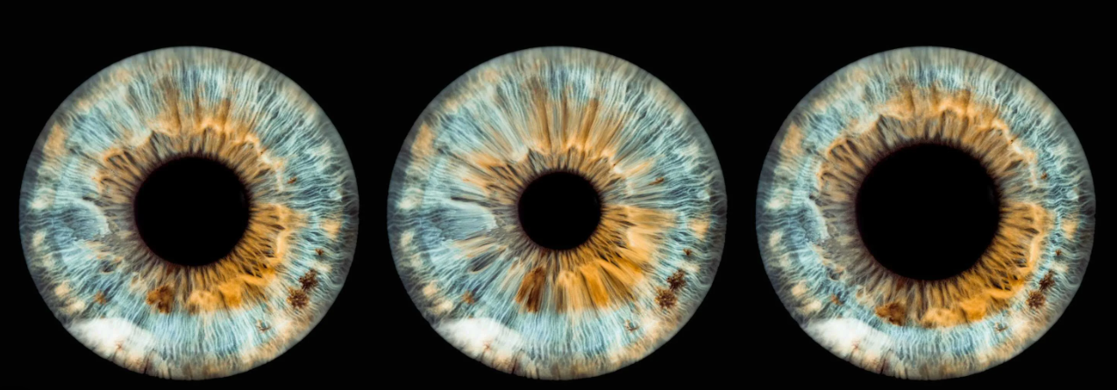
Experimental Findings(Pupil Size)
Pupil size exhibits significant changes in stressful environments
Pupillary response differs between high and low stress conditions
The phone camera able to detect this change

Slide 38

Limitation
This experiment is done in control environment
Accuracy may be affected by lighting conditions and camera quality
Applying environmental light in life can cause pupil changes

Slide 39
Conclusion
Pupil size and HRV validated as effective stress indicators
Smartphone cameras can detect pupil size and calculate
HRV in real-time Smartphones can serve as readily available, non-invasive stress

Slide 40

Future
Machine learning for personalized stress modeling
Continuous stress monitoring in daily life scenarios
Personalized well-being interventions and stress management
Occupational stress assessment and workplace wellness
Cognitive load evaluation in education and training

Slide 41

Thank You!

Slide 42
References
Kim, H.-G., Cheon, E.-J., Bai, D.-S., Lee, Y. H., & Koo, B.-H. (2018). Stress and Heart Rate Variability: A Meta-Analysis and Review of the Literature. Psychiatry Investigation, 15(3), 235–245. https://doi.org/10.30773/pi.2017.08.17
Census and Statistics Department, Hong Kong Special Administrative Region. (2023). Thematic Household Survey Report No. 77.
Steinhauer, S. R., Siegle, G. J., Condray, R., & Pless, M. (2004). Sympathetic and parasympathetic innervation of pupillary dilation during sustained processing. International journal of psychophysiology : official journal of the International Organization of Psychophysiology, 52(1), 77–86. https://doi.org/10.1016/j.ijpsycho.2003.12.005
Hirt, C., Eckard, M. & Kunz, A. Stress generation and non-intrusive measurement in virtual environments using eye tracking. J Ambient Intell Human Comput 11, 5977–5989 (2020). https://doi.org/10.1007/s12652-020-01845-y
Veltman, J. A., & Gaillard, A. W. K. (1998). Physiological workload reactions to increasing levels of task difficulty. Ergonomics, 41(5), 656-669. https://doi.org/10.1080/001401398186829

